Slide 1

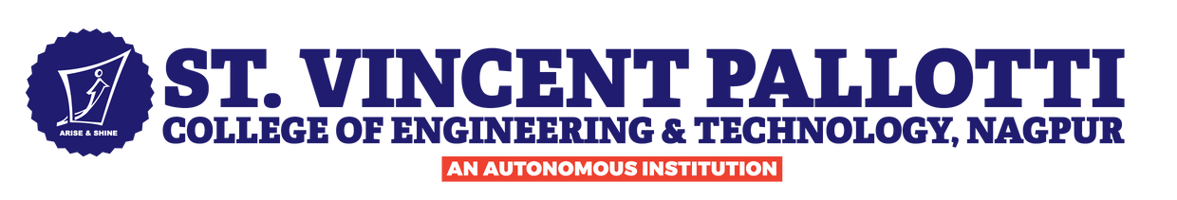



VXOAchievers
IEDC
Plastic waste surveillance system
VXOAchievers
Aanchal,Treslina,Trisha,Jason,Christo,Rohan
Smart Cities & Urban Solution

Slide 2
Problem Statement
VXOAchievers
Design and develop a high-precision, real-time plastic waste surveillance system capable of detecting, classifying, and predicting plastic waste accumulation within a 10-foot radius using multi-sensor fusion and intelligent analytics.
Description: This system should combine computer vision and environmental sensors to identify different plastic types accurately. It must differentiate plastic from similar materials under varying lighting and weather conditions. Predictive analytics will help forecast waste hotspots. Municipal dashboards should present actionable insights. Automated monitoring will reduce manual inspection efforts. The solution aims to improve smart waste management infrastructure.

Slide 3
Market Need
VXOAchievers
Global Plastic Waste Crisis
Over 400 million tons of plastic waste are generated annually, with less than 10% recycled. Plastic leakage into oceans and landfills continues to rise, especially in urban areas where unmanaged waste is highest.
Inefficiency of Current Waste Management
Current waste systems rely heavily on manual inspection and fixed collection schedules, with no real-time hotspot prediction or waste-type classification. This leads to high labor costs, overflowing bins, poor segregation, and increased landfill pressure
Public Health & Safety Concerns
Accumulated plastic near transportation, water sources, and residential zones can harbor pests and contaminate ecosystems.
Current detection approaches fail to provide early notifications.
Economic Costs of Plastic Pollution
Plastic accumulation increases waste collection costs, health risk management, and labor expenses.
Environmental cleanup without real-time analytics leads to reactive (not proactive) operations.
Smart City Infrastructure Demand
Governments worldwide are investing heavily in:
IoT-based urban monitoring
AI-powered surveillance
Automated waste management systems

Slide 4
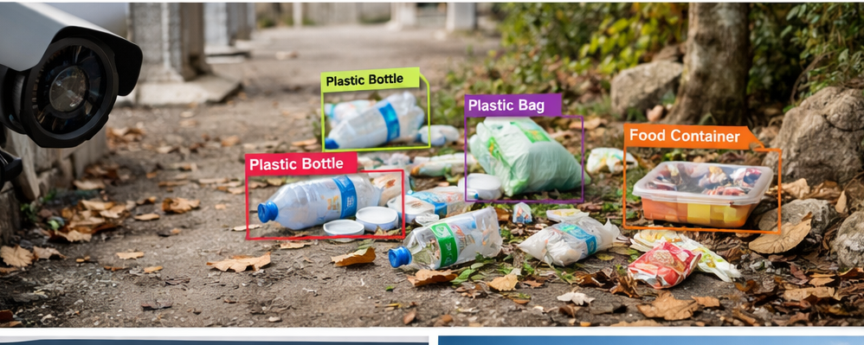
Proposed Solution
VXOAchievers
AI-Powered Computer Vision
Real-time detection of plastic waste within a 10-foot radius
Multi-class classification (bottles, bags, containers)
Accurate identification under varying lighting and weather conditions
Enables 24/7 automated monitoring
Multi-Sensor Fusion
Camera for visual detection
Depth sensor for size & distance estimation
Temperature & humidity sensors for environmental context
Reduces false detection and improves outdoor accuracy
Predictive Machine Learning
Analyzes historical and environmental data
Identifies recurring waste accumulation zones
Predicts peak waste times and overflow risks
Enables proactive waste management
Smart Municipal Dashboard
Real-time detection feed
Hotspot heatmaps & plastic distribution analytics
Automated alerts & historical trend insights
Supports data-driven decision making

Slide 5
VXOAchievers
Prototype/Demo Overview/Working
Model Screenshots
A real-time AI-based system that captures images, detects plastic waste using YOLO, classifies plastic types, predicts accumulation trends, and displays insights through a smart dashboard.
Real-Time Plastic Detection Engine Uses a YOLO model (confidence threshold 0.3) to detect plastic objects in images, filter relevant classes, and output annotated images with total count and type-wise breakdown.
✔ Fast detection ✔ Real-time annotation ✔ Accurate filtering
Plastic Classification Module Categorizes detected plastic into types (bottles, bags, containers, etc.) and logs structured data including type, confidence, and timestamp for analysis.
✔ Organized categorization ✔ Enables trend tracking
Detection History & Data Management
Stores recent detections (last 1000 entries) and maintains time-based records to support accumulation tracking and predictive modeling.
✔ Efficient data storage ✔ Supports forecasting
Predictive Analytics Module
Analyzes detection trends to predict future waste accumulation, assess hotspot risk levels, and generate automated recommendations.
✔ Enables proactive action ✔ Assists municipal decision-making
Smart Monitoring Dashboard
Displays detection statistics, classification breakdown, predictive insights, and real-time charts in an easy-to-use interface.

Slide 6
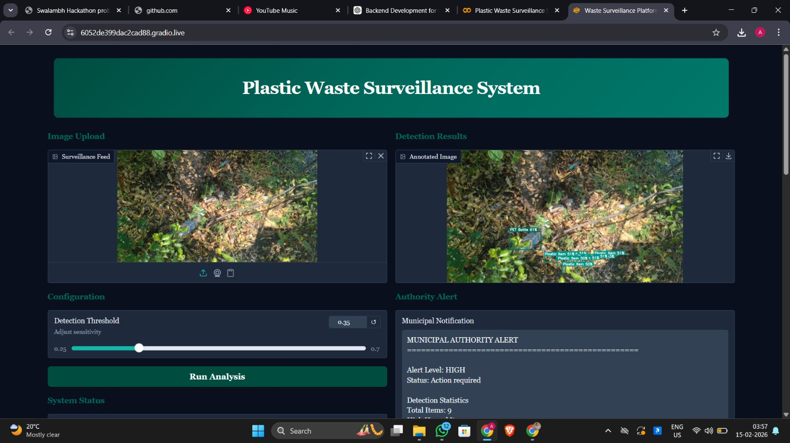
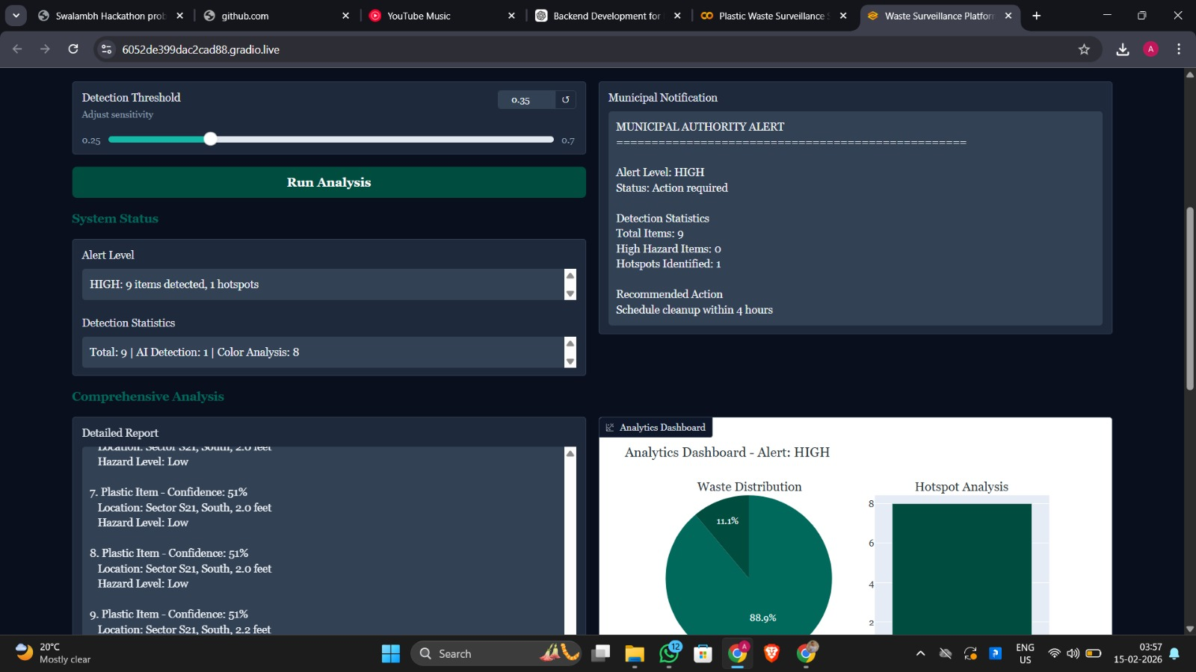
Prototype/Demo Overview/Working
Model Screenshots
VXOAchievers

Slide 7
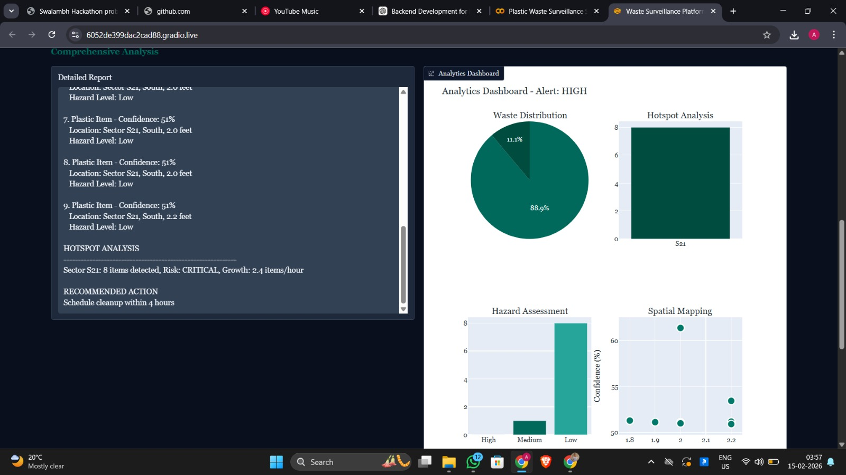
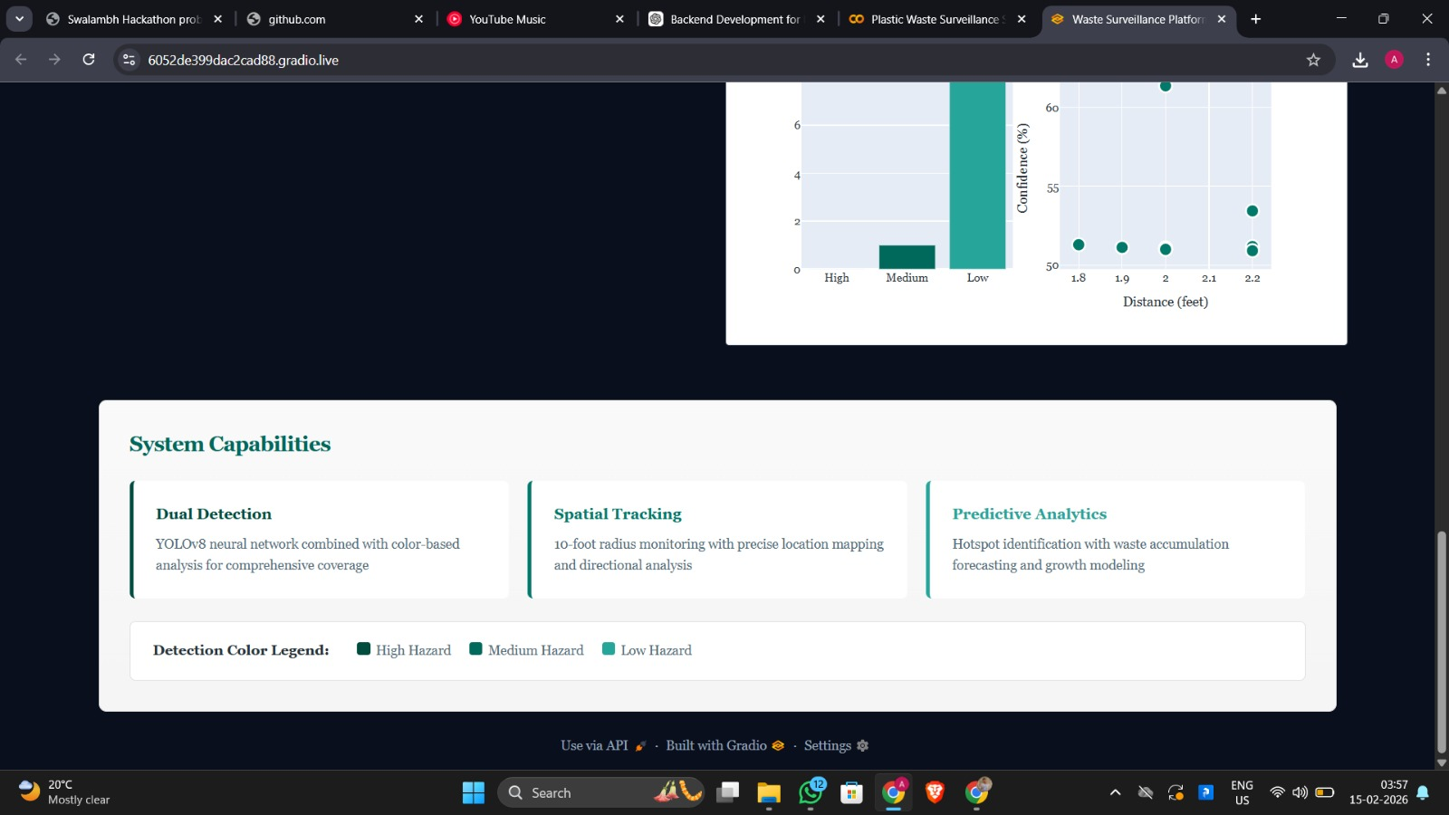
Prototype/Demo Overview/Working
Model Screenshots
VXOAchievers

Slide 8
VXOAchievers
Technology Stack
Artificial Intelligence & Computer Vision
YOLO (You Only Look Once) – Real-time object detection
Python – Core development language
OpenCV – Image processing
NumPy – Numerical computations
Data Processing & Analytics
Pandas – Data handling & analysis
Datetime module – Time-based tracking
Custom Predictive Analytics Algorithm
Trend detection
Hotspot risk analysis
Next-hour accumulation prediction
Frontend & Interface
Gradio – Interactive web-based dashboard
Image upload & webcam support
Real-time analytics display
Visualization plots

Slide 9
System Architecture
VXOAchievers
Input Layer
Captures images through upload or live webcam using the Gradio interface for real-time monitoring
Preprocessing Layer
Converts images to NumPy format, normalizes frames, and applies confidence filtering (0.3 threshold).
AI Detection Layer
Uses a YOLO model to detect objects, filter plastic classes, and extract bounding boxes, labels, and confidence scores.
Classification Module
Categorizes detected plastics (bottles, bags, containers, etc.) and logs type, confidence, and timestamp
Data Management Layer
Stores recent detections (last 1000 records) and tracks time-based accumulation trends
Predictive Analytics Engine
Analyzes historical data to predict waste trends, hotspot risk levels, and generate recommendations.
Dashboard & Visualization Layer
Displays annotated images, detection summaries, predictive insights, and real-time charts via a web interface.

Slide 10
Innovation & Uniqueness
VXOAchievers
Plastic-Specific Classification: Identifies and categorizes different plastic types, reducing false detections.
Real-Time AI Detection: Uses YOLO for instant, automated plastic detection via webcam or image input.
Predictive Analytics Integration: Forecasts accumulation trends, hotspot risks, and provides automated recommendations for proactive waste management.
Time-Series Tracking: Maintains structured detection history for trend analysis and accurate forecasting.
Smart Dashboard Interface: Displays annotated images, classification summaries, and visual insights for municipal decision-making.

Slide 11
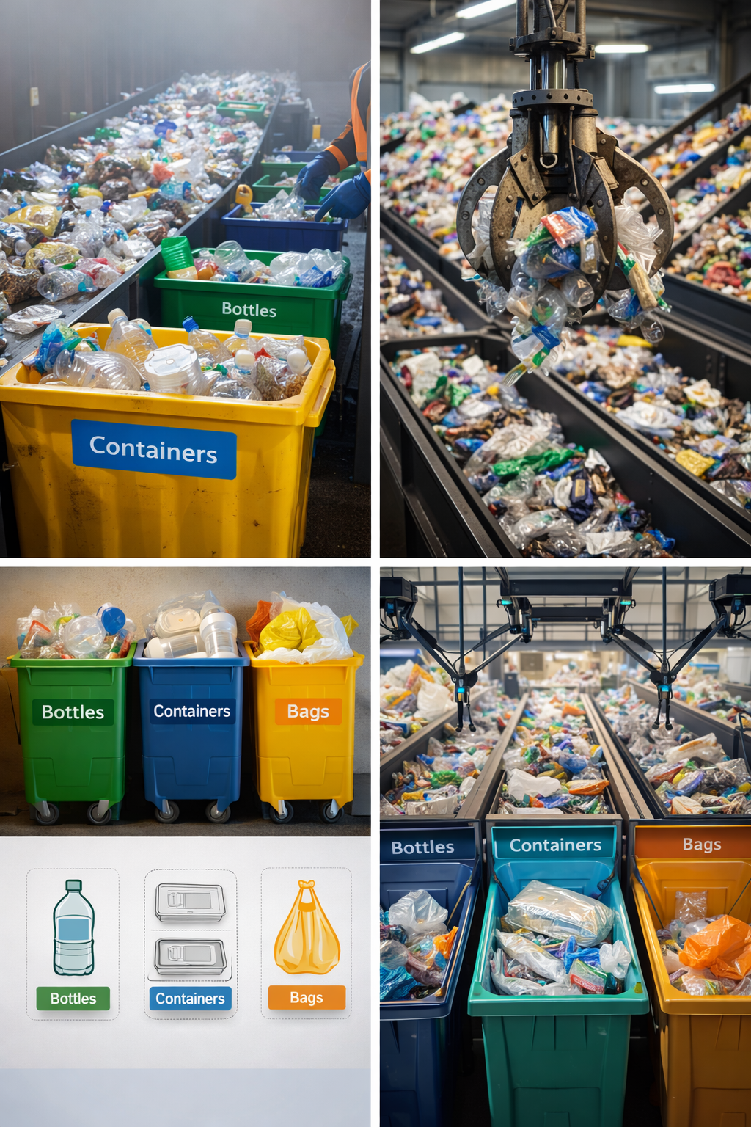
Business Modal
VXOAchievers
Target Customers
Municipal Corporations & Smart Cities – Optimize urban waste management
Waste Management Companies – Improve operational efficiency
Industrial Zones & Campuses – Maintain clean, sustainable environments
Commercial Complexes – Reduce plastic accumulation in high-traffic areas
Revenue Streams:
SaaS subscription for dashboard & analytics
Hardware + software bundle with maintenance
Premium analytics reports
Value Proposition:
Reduces manual inspection and operational costs
Provides real-time plastic detection and predictive forecasting
Enables data-driven municipal decisions
Scalable and adaptable to multiple locations and city infrastructure
Growth & Scalability:
Tiered subscription plans (Basic / Advanced / Enterprise)
Replicable model across cities, campuses, and industrial zones
Future expansion with IoT sensors and mobile citizen engagement.

Slide 12
Market & Competitors
VXOAchievers
Growing Plastic Waste Crisis
Rapid urbanization is increasing plastic waste generation.
Municipal bodies struggle with real-time monitoring.
Manual inspections are inefficient and costly.
Smart City Expansion
Governments are investing in smart infrastructure.
IoT and AI-based monitoring systems are in high demand.
Sustainability compliance is becoming mandatory.
Market Potential
Global smart waste management market is growing rapidly.
Increasing focus on:
Sustainable cities
ESG compliance
Circular economy initiatives
Target Market Segments
Municipal Corporations
Smart City Projects
Waste Management Companies
Industrial Zones
Educational Campuses
Commercial Complexes

Slide 13
Scalability
VXOAchievers
Technical Scalability
Modular AI architecture that supports multiple cameras, real-time YOLO processing, and deployment on edge devices or cloud. Enables both horizontal (more cameras) and vertical (better hardware/cloud) scaling.
Geographic Scalability
Deployable across cities, campuses, and industrial zones with centralized dashboard monitoring and location-based hotspot tracking.
Data Scalability
Efficient detection history management with cloud integration capability for large-scale storage and long-term trend analysis.
Functional Scalability
Expandable with IoT sensors, route optimization, automated alerts, and smart city control integration.
Business Scalability
Supports SaaS subscriptions, hardware-software bundles, and tier-based pricing for scalable revenue growth.

Slide 14
Chalanges Faced
VXOAchievers
Environmental Variability
Changing lighting conditions (day/night)
Shadows, reflections, and glare
Outdoor weather variations
Similar-Looking Objects
Plastic vs paper vs metal confusion
Transparent or partially visible plastics
Overlapping waste objects
Real-Time Performance Constraints
Maintaining speed while ensuring accuracy
Optimizing YOLO confidence threshold
Managing processing load for webcam input
Limited Dataset Availability
Lack of labeled outdoor plastic waste datasets
Need for filtering predefined plastic classes
Predictive Modeling Complexity
Limited historical data during prototype stage
Balancing simplicity vs realistic forecasting
Memory & Data Management
Storing detection history without system overload
Limiting to last 1000 records for efficiency

Slide 15
Future Roadmap
VXOAchievers
Strengthening the Core (Next 3–6 Months)
Improve model accuracy with a larger, real-world plastic dataset
Train for more plastic categories and complex outdoor scenes
Optimize performance for smoother real-time detection
Add better trend prediction using real historical data
Phase 2: Smart City Integration (6–12 Months)
Deploy pilot projects in selected municipal zones
Integrate with IoT environmental sensors
Enable automatic alerts for high-risk plastic hotspots
Add GPS-based waste mapping
Phase 3: Cloud & Large-Scale Expansion
Cloud-based centralized monitoring system
Multi-location dashboard for city-wide analytics
Long-term data storage for deep trend analysis
AI-powered route optimization for garbage trucks
Phase 4: Community & Citizen Engagement
Mobile app for citizen reporting
Public awareness dashboard
Gamification for cleaner neighborhoods

Slide 16
Social/Industrial Impact
VXOAchievers
Cleaner Communities
Real-time detection helps prevent plastic accumulation in public spaces, making neighborhoods cleaner and healthier.
Improved Public Health
Reducing plastic waste minimizes pest breeding, blocked drains, and pollution-related risks.
Environmental Protection
Early hotspot detection prevents plastic from reaching water bodies and ecosystems.
Citizen Awareness
Data-driven insights can promote responsible waste disposal and sustainability awareness.
Industrial Impact
Operational Efficiency
Waste management companies can optimize collection schedules using predictive insights.
Cost Reduction
Reduces manual inspection and reactive cleanup expenses.
Data-Driven Decision Making
Municipal bodies gain real-time analytics for better planning and resource allocation.
Smart City Enablement
Supports AI-powered urban infrastructure and sustainability initiatives.

Slide 17
Conclusion
team name
Plastic waste management today is largely reactive, manual, and inefficient. Our AI-powered Plastic Waste Surveillance System introduces a smarter approach — combining real-time detection, intelligent classification, and predictive analytics in one integrated solution.
By leveraging computer vision and data-driven insights, the system enables:
Faster waste identification
Proactive hotspot prevention
Optimized municipal decision-making
Scalable smart city integration
This solution is not just about detecting plastic — it’s about transforming waste management into a predictive, intelligent, and sustainable ecosystem.
With the right deployment and scaling, this system has the potential to make cities cleaner, operations smarter, and communities more environmentally responsible.

Slide 18
team name
Please ensure below pointers are met while submitting the Idea PPT:
Kindly keep the maximum slides limit up to 13-15.
Try to avoid paragraphs and post your idea in points /diagrams / Infographics /pictures
Keep your explanation precise and easy to understand
You can only use provided template for making the PPT without changing the layout .
Avoid copied content.
Note - You can delete this slide (Important Pointers) when you upload the details of your idea

